Slide 1
ECE 658 VLSI Design I Project Fall 2016
4x4 Array Multiplier
PRESENTED BY
SANKET SHANKAR KULKARNI- 31406022
JIGNESH FRANCIS LAWRANCE-31390272

Slide 2
Agenda
Objectives of the project
Introduction
Design Approach
Half Adder & Full Adder
Block Diagram
Schematics
Layouts
Future Work

Slide 3
Objectives and Requirements
To design a unsigned 4* 4 Array Multiplier
0.18 um CMOS Technology
Minimum Power Dissipation
Minimum Chip Area
Good Noise Margin
Less then 40 pin out

Slide 4
Introduction to Multiplier
Uses classic shift-add multiplication
All input bits are ANDed with each other to generate partial products
Full Adders are used to combine all partial products

Slide 5
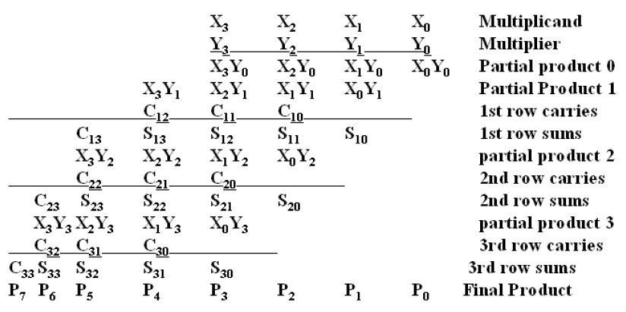
Partial Products in Multiplication

Slide 6
Design Approach
There are two sets of 4-bit inputs i.e. A0,A1,A2,A3 and B0,B1,B2,B3
All input bits are ANDed with each other which require 16 AND gates
16 Full Adder as CSA and 4 Full Adder as CPA are used in the design to collect all partial products.

Slide 7
Block Diagram of 4*4 Array Multiplier

Slide 8
Description
The circuit uses two main blocks:
1.Carry Save Adder (CSA)
2.Carry Propagate Adder (CPA)
CSA is composed of a AND gate followed by a full adder
CPA is composed of a simple full adder

Slide 9
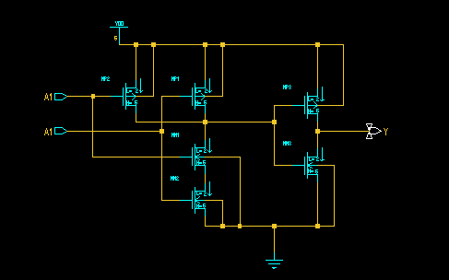
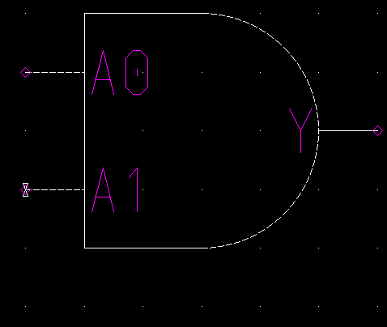
Transistor level Design For Gates
AND Gate
Circuit Diagram
Symbol

Slide 10
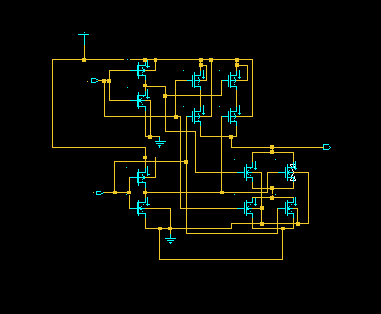
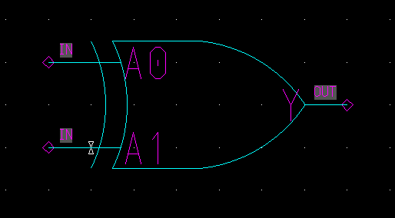
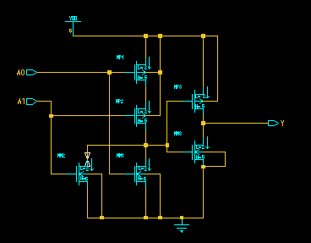
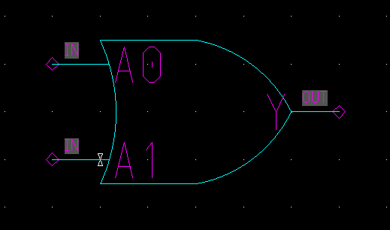
Circuit and symbol of XOR & OR Gate

Slide 11
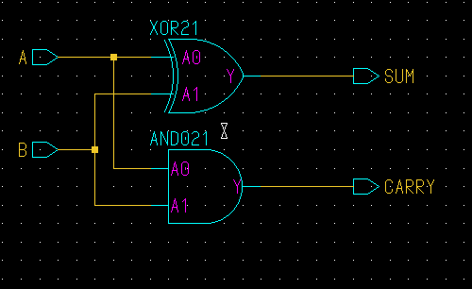
HALF ADDER
Schematic of Half Adder

Slide 12
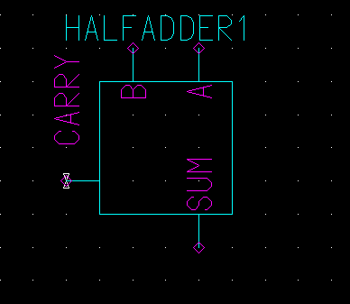
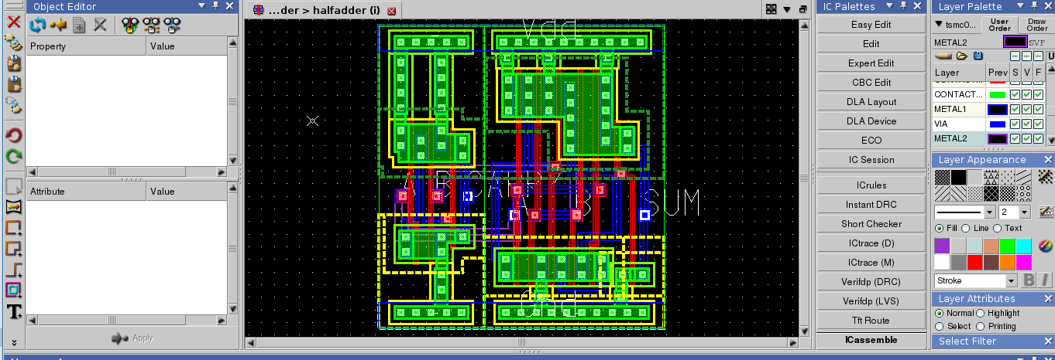
Half adder
Symbol
Layout

Slide 13
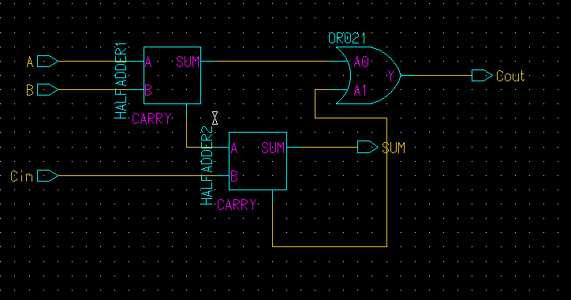
FULL ADDER
Schematic of Full adder

Slide 14
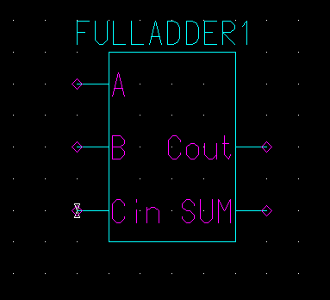
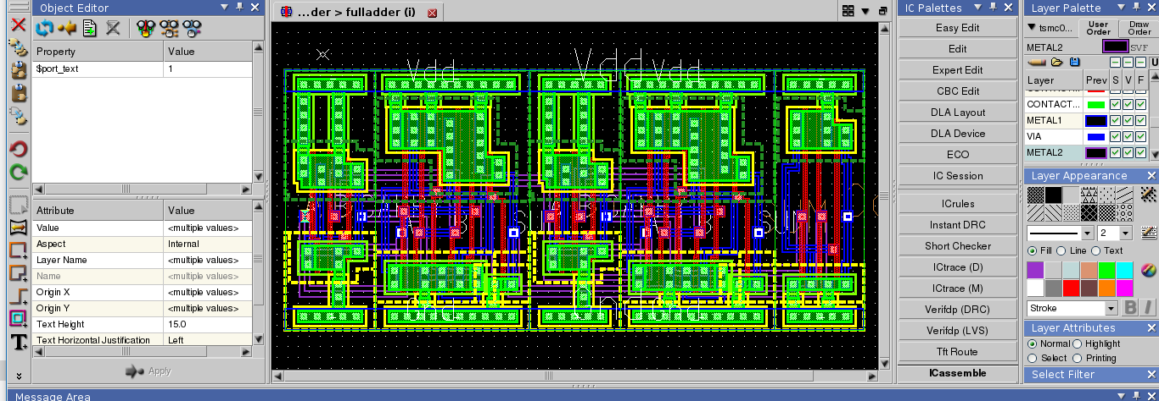
FULL ADDER
Symbol
Layout

Slide 15
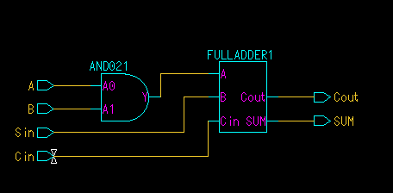
CARRY SAVE ADDER(CSA)
Schematic of CSA

Slide 16
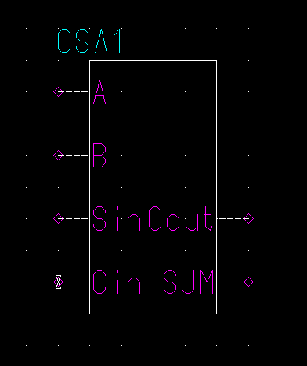
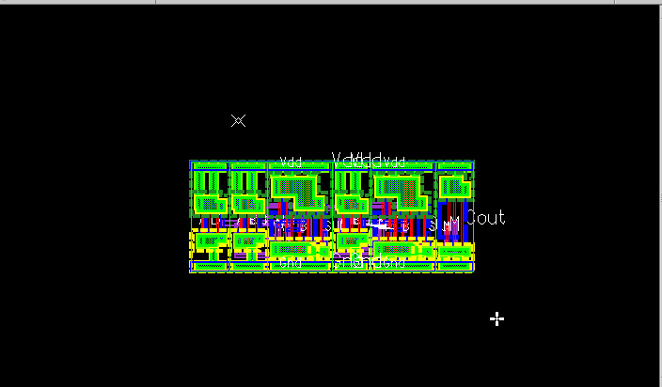
CARRY SAVE ADDER(CSA)

Slide 17
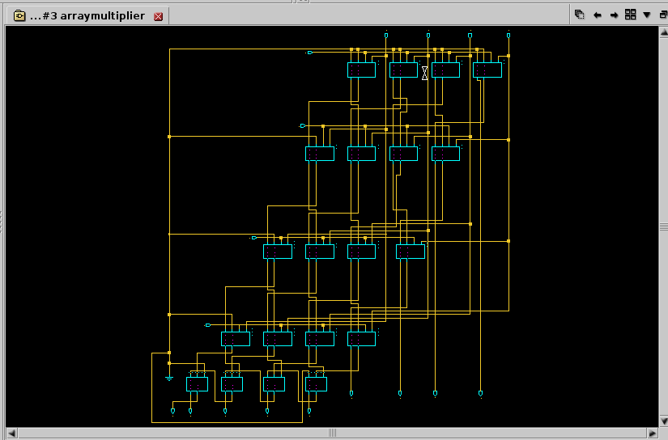
4*4 Array Multiplier

Slide 18
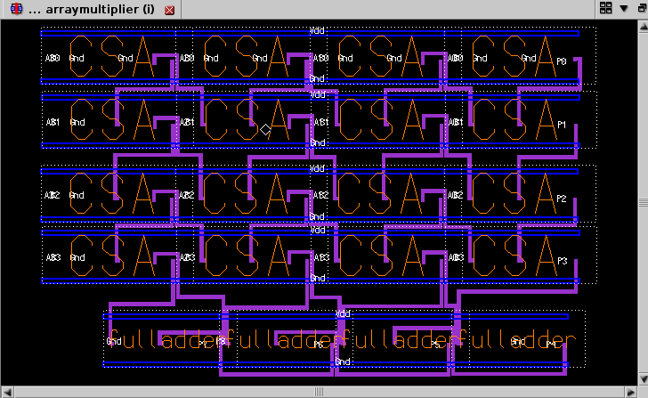
4*4 Array Multiplier

Slide 19
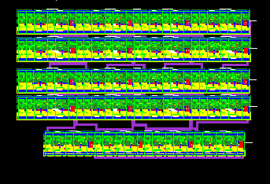
4*4 Array Multiplier

Slide 20
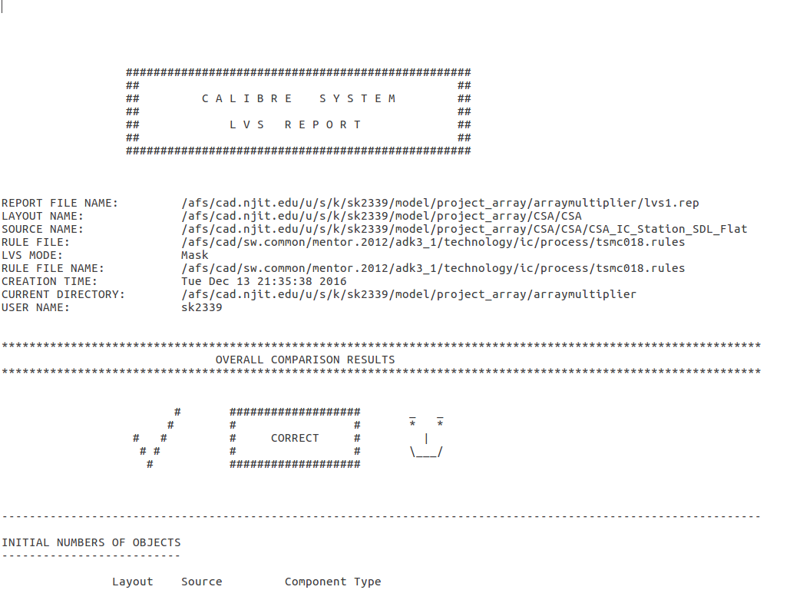
4*4 Array Multiplier
LVS Report

Slide 21
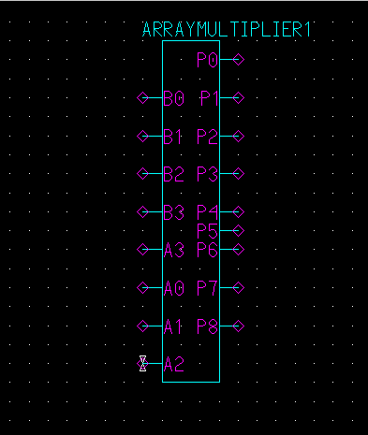
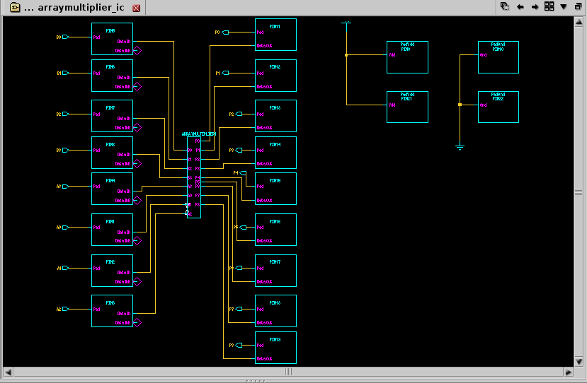
4*4 Array Multiplier
Symbol
Input and Output Pads

Slide 22
Future Work
Simulation Results
PAD Frame Generation

Slide 23
References:
Cmos VLSI Design ; A Circuit and Systems Perspective Neil H Weste, David Money Harris

Slide 24
THANK YOU

Slide 25


